Slide 1


‘Translating back’ common statistical test into their graphical causal language ancestors: adding practical statistical codes to the Jaccard & Jacoby ‘tests-causal’ model crosswalk
Emil Coman, PSTAT PhD, Health Disparities Institute, UConn Health
with direct assistance from
James Jaccard, Silver School of Social Work
New York University
Statistics Talk, Friday, Feb. 1
InCHIP (Ryan Refectory)

Slide 2
Promisory note:
I will add open source R code in daggity and lavaan and Onyx to give practical (and testable) meaning to theoretical causal models behind common statistical analyses (as shown in Jaccard & Jacoby, 2009: 1.i. Appendix): t-test; [ANOVA; Pearson chi-square;] regression; mediation; [causal mediation, and more. We will tackle also how and where to ‘add time’ in causal models].
Actually: just 1 variable and 2 variable models today, sorry.
Refer for more to: Jaccard, J., & Jacoby, J. (2009). Theory construction and model-building skills: A practical guide for social scientists: Guilford Press.
1.i. APPENDIX: Inferring Theoretical Relationships from the Choice of Statistical Tests
This is an applied worksession (partly), so:
For R codes and data for illustrations go to:

Slide 3
FIGURE 12.1. Causal models underlying statistical tests (text example on left, generic form on right). (a) Two Group/Condition t-Test; (b) One-Way Analysis of Variance; (c) Chi-Square Test of Independence and Test of Proportions; (d) Pearson Correlation/Linear Regression: Direct Cause Model;

Slide 4
Main points
Statistical tests are clueless without a causal model;
Research questions need: info about research design and on a working model of how data is generated by nature (with researcher’s or policy maker’s input sometimes).
In Null Hypothesis Significance Testing (NHST) framework: one needs a model for the ‘null’ state.
Instead of mere NHST from statistical tests, the focus shifts to causally well-informed models and tests of differences in fit between alternative/nested models.
The easiest way to model is graphically: will show how with lavaan and Ωnyx parametrically (and with data), and with dagitty and MIIVsem nonparametrically (data-less).
DAGitty - drawing and analyzing causal diagrams (DAGs)
Causal Inference In Statistics: A Companion for R Users – DAGitty

Slide 5
Who we are:
-HDI: UConn Health Disparities Institute
-BMoC: CT Report Card on Health Equity Among Boys And Men Of Color (BMoC) in CT: full report ; interview on WNPR with Dr. Wizdom Powell
-Biostatistics club – UConn Health formerly CICATS, now Connecticut Convergence Institute for Translation in Regenerative Engineering

Slide 6
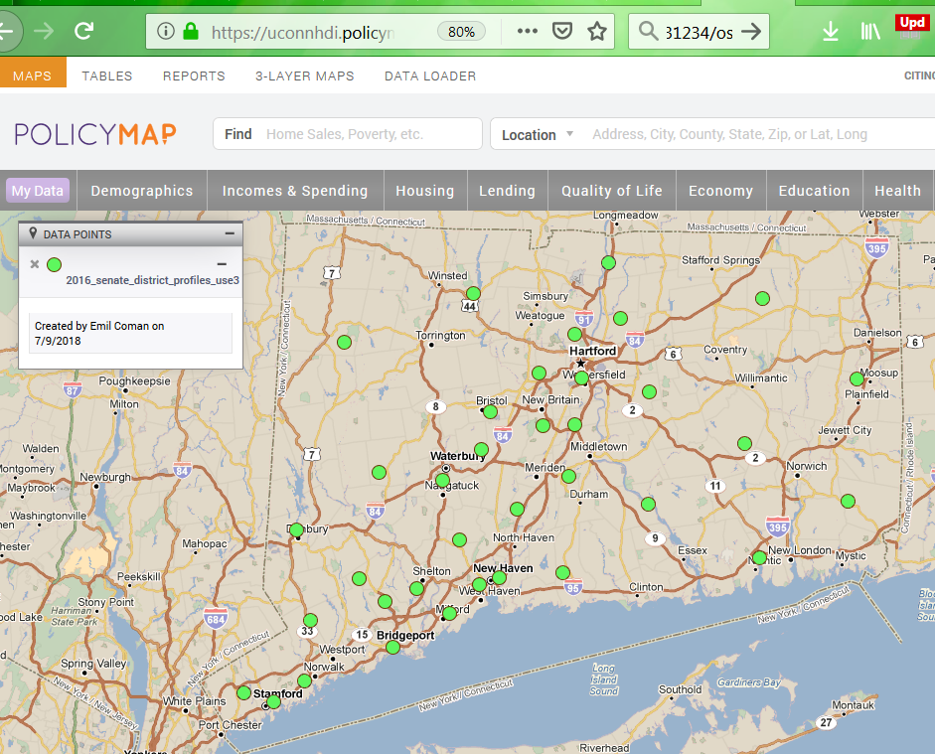
HDI: UConn Health Disparities Institute
PolicyMap https://uconnhdi.policymap.com

Slide 7
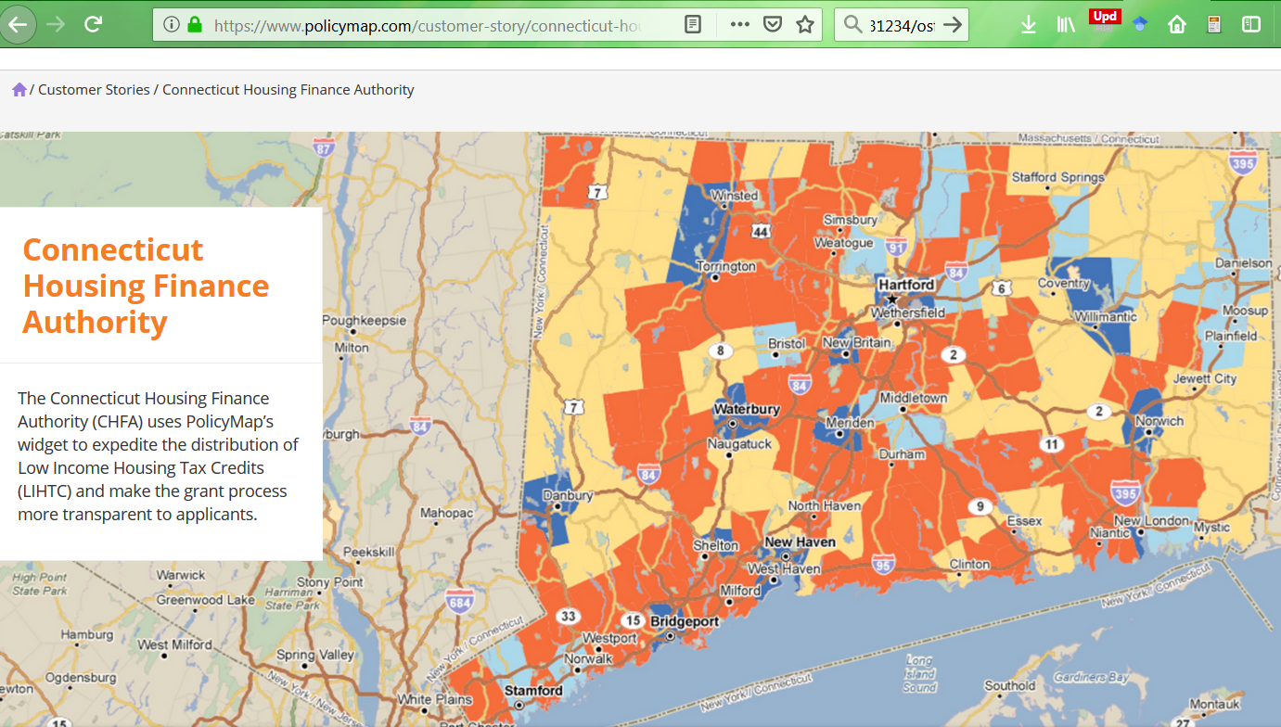
HDI: UConn Health Disparities Institute
PolicyMap https://uconnhdi.policymap.com

Slide 8
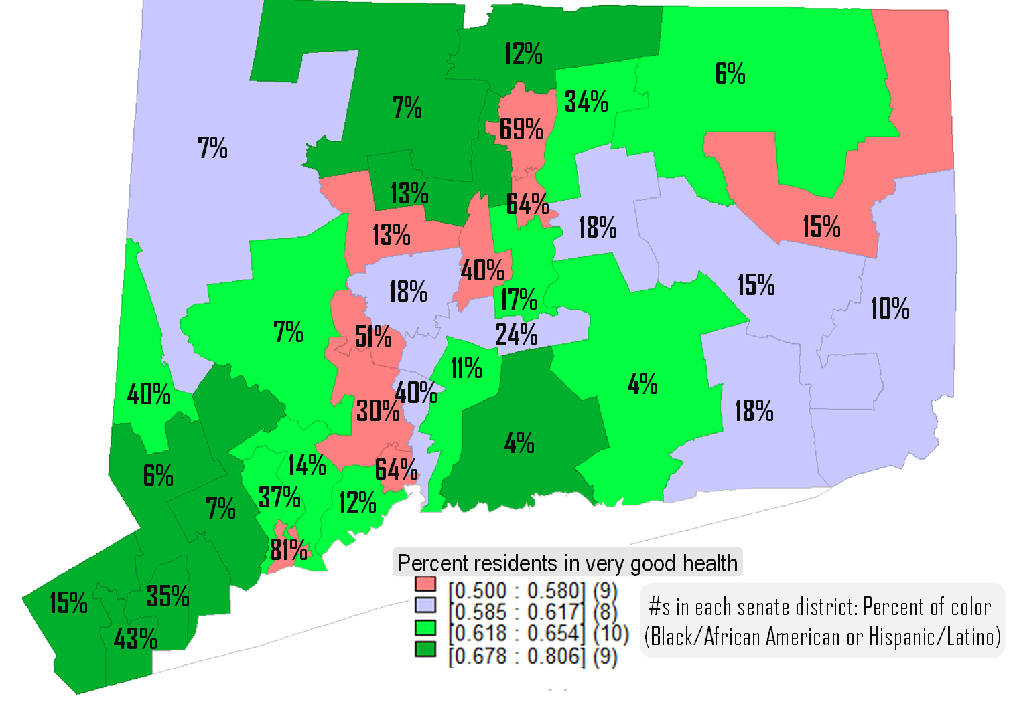
Example of what one can do with PolicyMap data
Spatial models reveal a significant relationship between lower percent minority residents and higher percent of residents reporting very good health, across CT state districts. Senate districts with more minorities have fewer residents reporting very good health. (BMoC report, HDI).
The 9 red districts have the least residents reporting very good health (<58%) , while the 8 blue districts have between 58% and 62% residents enjoying very good health. The 10 light green districts have 62%--65% residents with good health, and the 9 dark green districts are those with >68% residents reporting very good health. The data was combined from several sources by DataHaven [6], and is freely downloadable.
To analyze data further:
Lamb, E. G., Mengersen, K. L., Stewart, K. J., Attanayake, U., & Siciliano, S. D. (2014). Spatially explicit structural equation modeling. Ecology, 95(9), 2434-2442.
Liu, X., Wall, M. M., & Hodges, J. S. (2005). Generalized spatial structural equation models. Biostatistics, 6(4), 539-557.
Wall, M. M. (2012). Spatial Structural Equation Modeling.
In R. Hoyle (Ed.), Handbook of Structural Equation Modeling (pp. 674-689). New York: Guilford Press.

Slide 9
Statistical and software traditions - simplified
Scientific
Domain
Epidemiology/
Biostatistics
Economics
Social
Sciences
Statistics/
Mathematics
SAS
SPSS
Minitab
Software
R
Stata
Mplus
Cross-cutting
Excel/Sheets
Some use combinations of code, or many at once.

Slide 10
‘Tracing rule’ powers at work with 1 variable
We add σ‘s, and run the ‘tracing’ tool along directed and bidirectional paths (except common effects along the way; and we can ‘go back in time) + grab the cov/ariance of the variable at the ‘root’ on the pathway.
σ_{uu}
u
1
Y
Y
σ_{YY}
An exogenous variable (to the model!) is a ‘big fat disturbance’ or structural error: all of its variance is error, or unexplained. So:
Y = 1 · u
and therefore
σ_{YY} = σ_{uu}
Cov(YY) = σ_{YY}
“The correlation between two variables can be shown to equal the sum of the products of the chains of path coefficients along all of the paths by which the variables are connected.” [:115]
Wright, S. (1921). Systems of mating. I. The biometric relations between parent and offspring. Genetics, 6(2), 111.

Slide 11
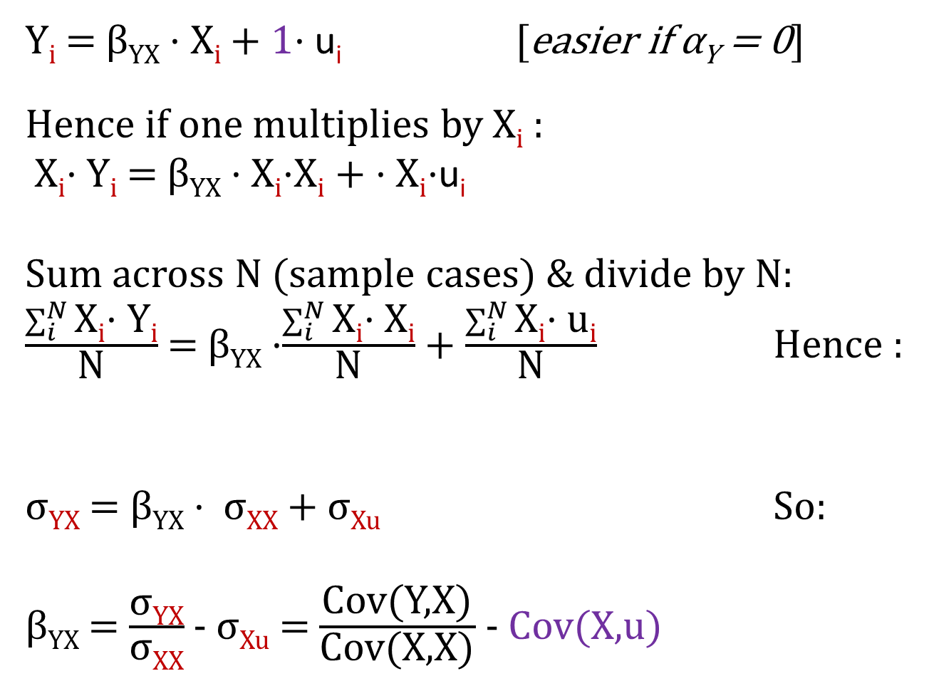

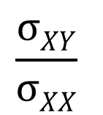
Regression and how potential ‘change’ is deduced
Y_{i} = β_{YX} · X_{i} + 1· u_{i} [easier if α_{Y} = 0]
Hence if one multiplies by X_{i} :
X_{i}· Y_{i} = β_{YX} · X_{i}·X_{i} + · X_{i}·u_{i}
Sum across N (sample cases) & divide by N:
$\frac{\sum_{i}^{N}{\text{X}\text{i}\text{· }\text{Y}\text{i}}}{\text{N}}$ = β_{YX} ·$\frac{\sum_{i}^{N}{\text{X}\text{i}\text{· }\text{X}\text{i}}}{\text{N}}$ + $\frac{\sum_{i}^{N}{\text{X}\text{i}\text{· }\text{u}\text{i}}}{\text{N}}$ Hence :
σ_{YX} = β_{YX} · σ_{XX} + σ_{Xu} So:
β_{YX} = $\frac{\text{σ}\text{YX}}{\text{σ}\text{XX}}$ - σ_{Xu} = $\frac{\text{Cov}\text{(}\text{Y}\text{,}\text{X}\text{)}}{\text{Cov}\text{(}\text{X}\text{,}\text{X}\text{)}}$ - Cov(X,u)
Regression
u
$$\text{1}$$
Y
$$\frac{σXY}{σXX}$$
X
With deviation scores one gets α_{Y} = 0.
Notation: u is better here than ε because it represents ‘ignored-for-now-other-causes’,
not just ‘error’.
Basic stats

Slide 12
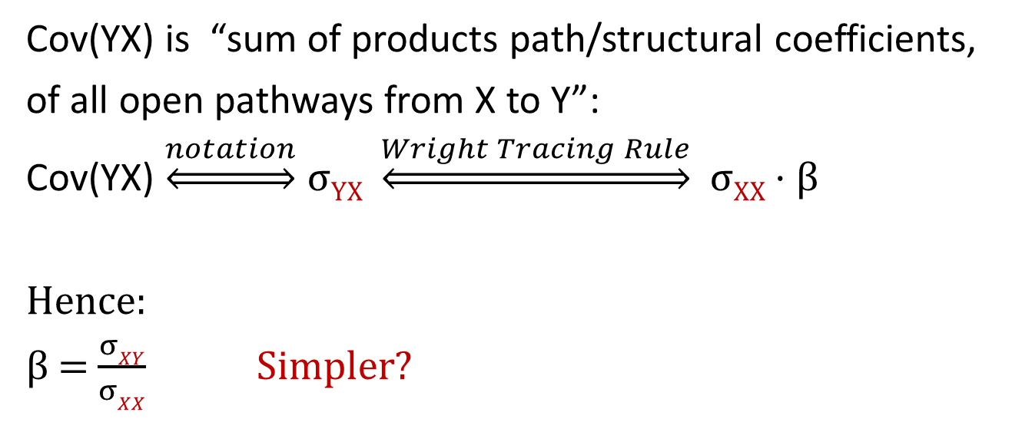
‘Tracing rule’ powers at work
σ_{uu}
u
Cov(YX) is “sum of products path/structural coefficients,
of all open pathways from X to Y”:
Cov(YX) $\underset{⇔}{notation}$ σ_{YX} $\underset{⇔}{Wright Tracing Rule}$ σ_{XX} · β
Hence:
β = $\frac{σXY}{σXX}$ Simpler?
1
Y
X
β
σ_{XX}
“The correlation between two variables can be shown to equal the sum of the products of the chains of path coefficients along all of the paths by which the variables are connected.” [Wright:115]
Wright, S. (1921). Systems of mating. I. The biometric relations between parent and offspring. Genetics, 6(2), 111.

Slide 13
‘Tracing rule’
“Tracing rules (or Wright’s rules) are simply a way to estimate the covariance between two variables by summing the appropriate connecting paths.” [1:23]
“Trace all paths between two variables (or a variable back to itself), multiplying all the coefficients along a given [open] path.
i. You can start by going backwards along a single-headed arrow, but once you start going forward along these arrows you can no longer go backwards.
ii. No loops! That is, you cannot go through the same variable more than once for a given path.
iii. At maximum, there can be one double-headed arrow included in a path.
iv. After tracing all the paths for a given relationship, sum all the paths.” [1:24]
+v. EC: A ‘collider (z₁--> w <-- z₂) is: not open/closed/disconnected
Cannot go forward THEN backwards ‘in time’
“The correlation between two variables can be shown to equal the sum of the products of the chains of path coefficients along all of the paths by which the variables are connected.” [2:115]
1. Beaujean, A. A. (2014). Latent variable modeling using R: A step-by-step guide: Routledge.
2. Wright, S. (1921). Systems of mating. I. The biometric relations between parent and offspring. Genetics, 6(2), 111.

Slide 14
Original translational insight
Not clear which came first:
1. The decomposition idea
2. The regression->path conceptual leap.
Wright, S. (1921). Systems of mating. I. The biometric relations between parent and offspring. Genetics, 6(2), 111.

Slide 15
First SEM model: 1920
“The path coefficient, measuring the importance of a given path of influence from cause to effect, is defined as the ratio of the variability of the effect to be found when all causes are constant except the one in question, the variability of which is kept unchanged, to the total variability.
Variability is measured by the standard deviation.” [1]:329
1. Wright, S. (1920). The relative importance of heredity and environment in determining the piebald pattern of guinea-pigs. Proceedings of the National Academy of Sciences, 6(6), 320-332.

Slide 16
Original insight
The ‘multiply- along-the-trek’ rule may have come from the derivatives of composite functions formulas:
Coman, E. N., Thoemmes, F., & Fifield, J. (2017). Commentary: Causal Effects in Mediation Modeling: An Introduction with Applications to Latent Variables. Frontiers in Psychology, 8(151). doi:10.3389/fpsyg.2017.00151

Slide 17
Origins of the Bayesian Networks
“Networks employing Directed Acyclic Graphs (DAGs) have a long and rich tradition, starting with the geneticist Wright (1921). He developed a method called path analysis [Wright, 1934] which later on, became an established representation of causal models in economics [Wold, 1964], sociology [Blalock, 1971] and psychology [Duncan, 1975]. Influence diagrams represent another application of DAG representation [Howard and Matheson, 1981], [Shachter, 1988] and [Smith, 1987]. These were developed for decision analysis and contain both chance nodes and decision nodes (our definition of causal models excludes decision nodes). Recursive models is the name given to such networks by statisticians seeking meaningful and effective decompositions of contingency tables (Lauritzen, 1982), (Wermuth & Lauritzen, 1983], [Kiiveri et al, 1984]. Bayesian Belief Networks (or Causal Networks) is the name adopted for describing networks that perform evidential reasoning ((Pearl, 1986a, 1988]). This paper establishes a clear semantics for these networks that might explain their wide usage as models for forecasting, decision analysis and evidential reasoning.” [1]:136
1. Geiger, D. and J. Pearl, On the logic of causal models. arXiv preprint arXiv:1304.2355, 1988.

Slide 18
Causal chains: early origins
“The φ's may be thought of as quasiprobabilities of the events. They are defined successively as follows [2: 48]:
Φ₀ = I.
Φ₁ = π₁.
Φ₂ = I – (I – π₂) · (I - Φ₁·π₃) .
Φ₃ = I – (I – Φ₁·π₄) · (I – Φ₂·π₅) .
Φ₄ = I – (I – Φ₁·π₆) · (I – Φ₂·π₇) · (I – Φ₃·π₈) .
S(π) = Q(Φ₄ , o) = -log (I – Φ₄) .
Φ₁
π₁
F(Φ₀ = I)
π₄
π₆
π₃
Φ₃
π₈
π₂
π₅
E Φ₄
π₇
Φ₂
1. Good, I. J. (1961). A causal calculus (I). The British Journal for the Philosophy of Science, 11(44), 305-318.
2. Good, I. J. (1961). A causal calculus (II). The British Journal for the Philosophy of Science, 12(45), 43-51.

Slide 19
Origins of the Bayesian Networks
““¹ Probabilistic formulae of this kind are shorthand notation for the statement that for any
instantiation i of the variables x₁, x₂ . . . . . x_{n}, the probability of the joint event (x₁ = i ) & (x₂ = i₂)
&... & (x_{n} = i_{n}) is equal to the product of the probabilities of the corresponding conditional
events (x₁ = i₁), (x₂ = i₂ if x₁ = i₁), (x₃ = i₃ if (x₂ = i₂ & x₁ = i₁) ) . . . . . For this expansion to be
valid, we must require that P(E)> 0 for all conditioning events E.” So, for example, the distribution corresponding to the graph of Fig. 1 can be written by inspection:
P(x₁, x₂, x₃, x₄, x₅, x₆) =
= P(x₆|x₅) · P(x₆|x₅) · P(x₅|x₂, x₃) ·
P(x₄|x₁, x₂) P(x₃|x₁) · P(x₂|x₁) · P(x₁) (Pearl 1986):244-5
FIG. 1. A typical Bayesian network representing the distribution
P(x₁… x₆) = P(x₆|x₅) · P(x₅|x₂, x₃) · P(x₄|x₁, x₂) P(x₃|x₁) · P(x₂|x₁) · P(x₁)
Pearl, J. (1986). Fusion, propagation, and structuring in belief networks. Artificial intelligence, 29(3), 241-288. doi:http://dx.doi.org/10.1016/0004-3702(86)90072-X

Slide 20
Modern Bayesian Networks
“In words, the qualitative statistical dependencies shown in this small Bayesian network can be described as follows:
1. A recent trip to Asia (A) increases the chances of tuberculosis (T).
2. Smoking (S) is a risk factor for both lung cancer (L) and bronchitis (B).
3. The presence of either € tuberculosis or lung cancer can be detected by an X-ray result, but the X-ray alone cannot distinguish between them.
4. Dyspnoea (D) (shortness of breath) may be caused by bronchitis (B), or either € tuberculosis or lung cancer.
Each node represents a variable that can be in a discrete number of possible states. We write x_{i} for the variable representing the different possible states of the node i. In addition to the qualitative dependencies described by the Bayesian network graph, there are quantitative statistical relationships that we assign to each arrow in the graph. Associated with each arrow is a conditional probability: for example, we write p(x_{L}| x_{S}) for the conditional probability of a patient having lung cancer given that he does or does not smoke. For this link, we say that the S node is the ‘parent’ of the L node because x_{L} is conditionally dependent on x_{S}. Some nodes like the D node might have more than one parent; thus we write p(x_{D}| x_{E}, x_{B}) for the conditional probability of having dyspnoea. “ (Yedidia, Freeman et al. 2003):6
Fig. 1 The fictional “Asia” Bayesian network, taken from (Lauritzen and Spiegelhalter 1988)
The over-all probability
p([x]) = p (x_{A}, x_{S}, x_{T}, x_{L}, x_{B}, x_{E}, x_{X}, x_{D})
that the patient has some combination of symptoms, test results, and diseases is just
the product of all probabilities of the parent nodes and all the conditional probabilities’:
p([x]) = p(x_{A}) · p(x_{S}) · p(x_{T}|x_{A}) · p(x_{L}|x_{S}) · p(x_{B}|x_{S}) · p(x_{E}|x_{L}, x_{T}) · p(x_{D}|x_{B} , x_{E}) · p(x_{X}|x_{E})
(1: p. 6)
1. Spiegelhalter, D. J., & Lauritzen, S. L. (1988). Statistical reasoning and learning in knowledge-bases represented as causal networks Expert Systems and Decision Support in Medicine (pp. 105-112): Springer.

Slide 21
Origins of the Bayesian Networks
Figure 1 shows an example of such a diagram, derived from a prototype system MUNIN which forms part of a collaborative ESPRIT project to build an advisor in electromyography (EMG).
Spiegelhalter, D. J., & Lauritzen, S. L. (1988). Statistical reasoning and learning in knowledge-bases represented as causal networks Expert Systems and Decision Support in Medicine (pp. 105-112): Springer.

Slide 22
Not unlike the BayesiaLab interface!
Bayesian Networks for Health Economics and Public Policy Research slide 139

Slide 23
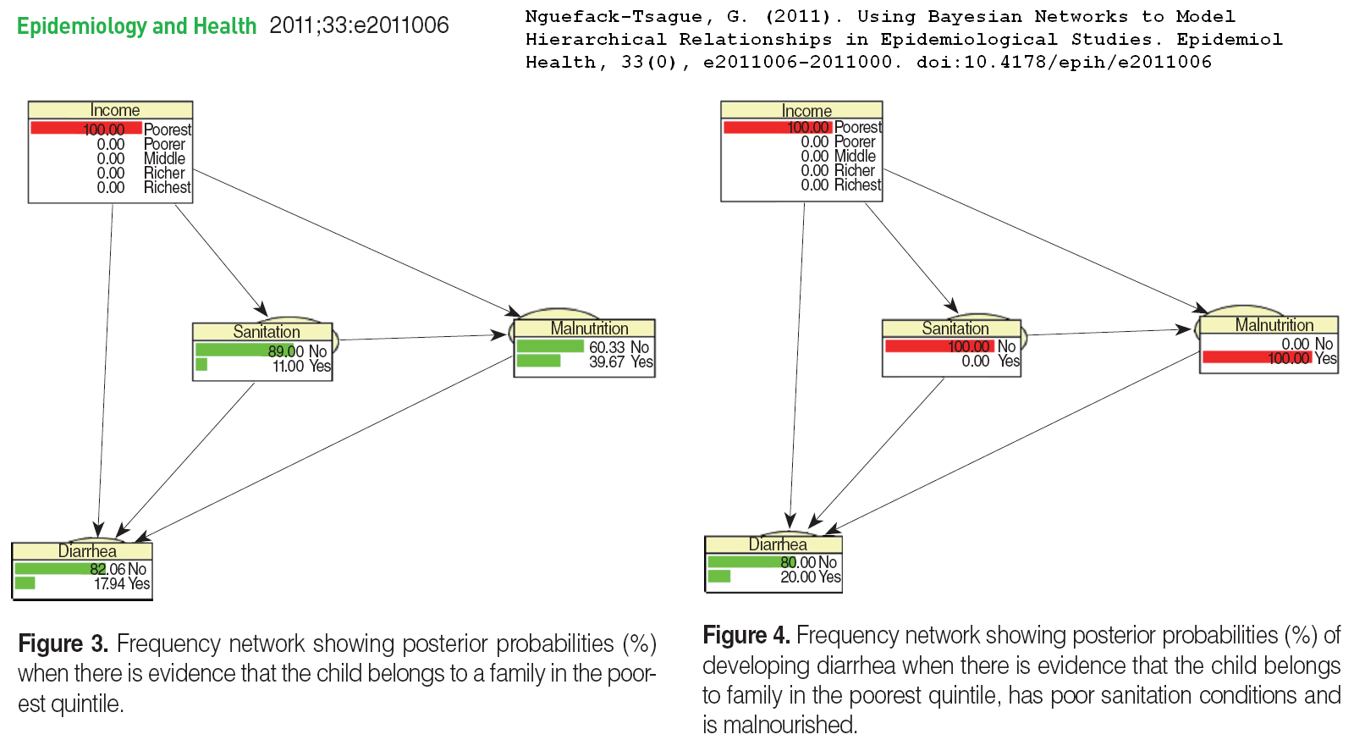
Bayesian network example
BayesiaLab likely
Nguefack-Tsague, G. (2011). Using Bayesian Networks to Model Hierarchical Relationships in Epidemiological Studies. Epidemiol Health, 33(0), e2011006-2011000. doi:10.4178/epih/e2011006

Slide 24
How inventions ‘happen’
“Jamie Robins (Figure 9.9), a pioneering statistician and epidemiologist at Harvard University who, together with Sander Greenland at the University of California, Los Angeles, is largely responsible for the widespread adoption of graphical models in epidemiology today. We collaborated for a couple of years, from 1993 to 1995, [and] he got me thinking about the problem of sequential intervention plans, which was one of his principal research interests.
After Jamie flew out to California to meet me on hearing about the “napkin problem” (Chapter 7), he was keenly interested in applying graphical methods to the sequential treatment plans that were his métier. Together we came up with a sequential back-door criterion for estimating the causal effect of such a treatment stream. I learned some important lessons from this collaboration. In particular, he showed me that two actions are sometimes easier to analyze than one because an action corresponds to erasing arrows on a graph, which makes it sparser.” JP p. 328 & 330
“In 1976 Terry Speed invited me to Perth, Australia where he conducted a research seminar exploring relations between statistics and statistical physics. Among other things we studied the relation between the notion of interaction as used in contingency table analysis and in thermodynamics. To our delight they were formally the same […]” (Lauritzen 1996)
Pearl, J., & Mackenzie, D. (2018). The Book of Why: The New Science of Cause and Effect: Hachette UK. My notes
Lauritzen, S. L. (1996). Graphical models: Clarendon Press.

Slide 25
Ωnyx added value
“Structural Equation Modeling is a frequently used multivariate analysis technique in the behavioral and social sciences. SEM are linear models of both observed and latent variables and their relationships. The maximum-likelihood-framework allows estimation of structural parameters even on the latent level by modeling the covariances and expectations of the observed variables.
There are various text books that cover the essentials of SEM, for example, Bollen(1989). SEM can be conceived of as a unification of several multivariate analysis techniques under a single framework. Particularly, linear regression, ANOVA, correlation, path analysis, factor analysis, autoregression, and growth curve modeling can be considered special cases of SEM.”
Ωnyx documentation from: http://onyx.brandmaier.de/documentation/

Slide 26
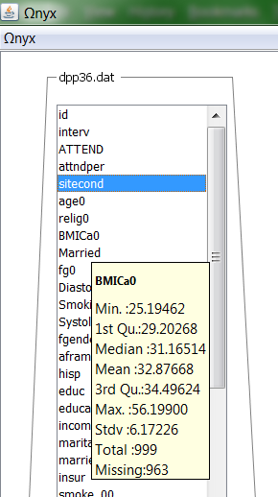
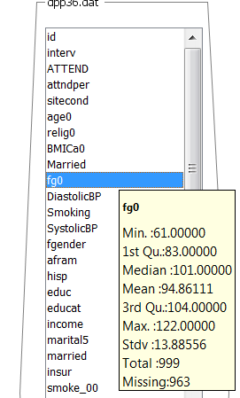
Robin Beaumont Ωnyx Youtube
Timo von Oertzen, Brandmaier, A. M., & Tsang, S. (2015). Structural Equation Modeling With Ωnyx. Structural Equation Modeling: A Multidisciplinary Journal, 22(1), 148-161. doi:10.1080/10705511.2014.935842

Slide 27
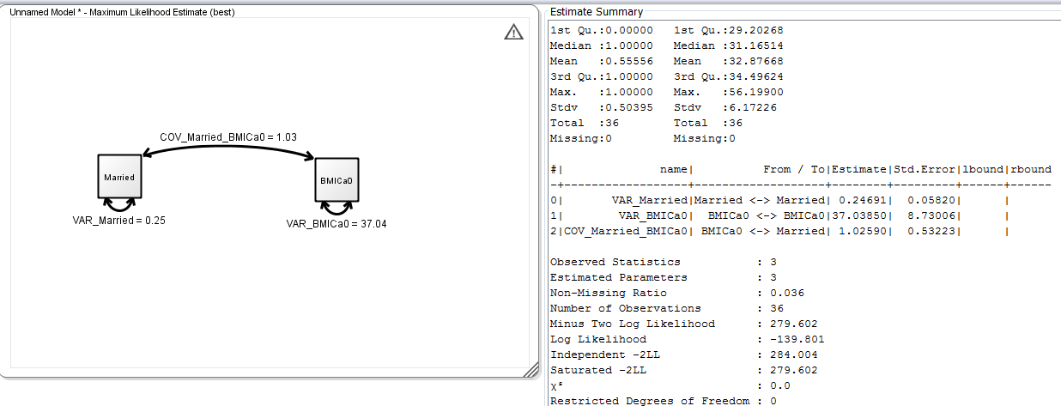
Robin Beaumont Ωnyx Youtube

Slide 28
R 2 variable ‘model’
plot(fg0~BMICa0, data = dpp_36males_Hartford_fewer)
> with (dpp_36males_Hartford_fewer, cov(fg0,BMICa0))
[1] -10.39484
> mycorr <- with (dpp_36males_Hartford_fewer, cor(fg0,BMICa0, method="pearson"))
> mycorr
[1] -0.121286
> rsquared <- mycorr^2
> rsquared
[1] 0.0147103
> mycorr <- with (dpp_36males_Hartford_fewer,
cor.test(fg0,BMICa0, alternative="two.sided",
method="pearson"))
> mycorr
Pearson's product-moment correlation
data: fg0 and BMICa0
t = -0.71247, df = 34, p-value = 0.481
alternative hypothesis: true correlation is
not equal to 0
95 percent confidence interval:
-0.4325846 0.2158507
sample estimates:
cor
-0.121286

Slide 29
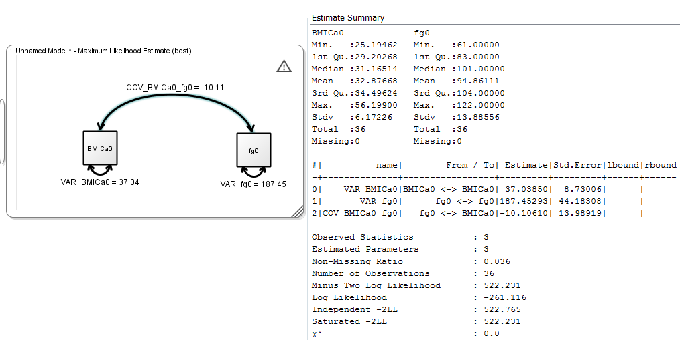
Robin Beaumont Ωnyx Youtube

Slide 30
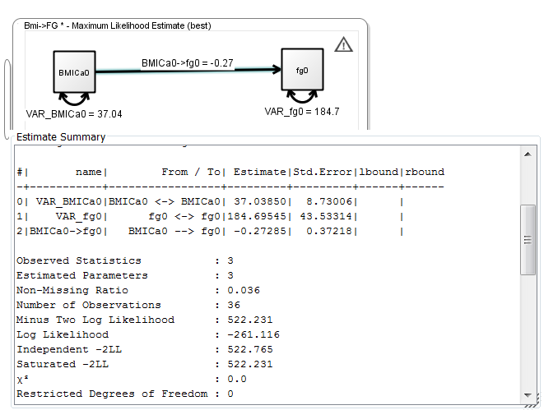
Robin Beaumont Ωnyx Youtube

Slide 31
BMI of males: by marital status
| Observed Bootstrap Normal-based
| Coef. Std. Err. z P>|z| [95% Conf. Interval]
--------+----------------------------------------------------------------
Skew | -.0148387 .4194667 -0.04 0.972 -.8369783 .8073009
kurtosis| 1.515828 .410243 3.69 0.000 .7117664 2.319889
------------------------------------------------------------------------------
| Observed Bootstrap Normal-based
| Coef. Std. Err. z P>|z| [95% Conf. Interval]
---------+----------------------------------------------------------------
Skew | 1.539829 .5361251 2.87 0.004 .4890433 2.590615
kurtosis | 5.160547 1.927927 2.68 0.007 1.381881 8.939214
------------------------------------------------------------------------------

Slide 32
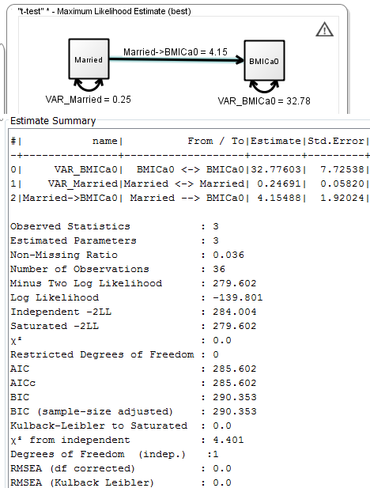
Marriage -> BMI of males
Z value for the Married->BMI is 4.15488/1.92024 = 2.16373
> zis<-4.15488/1.92024
Zis
[1] 2.16373
t.test
t = -2.1028, df = 34, p-value = 0.04296
sample estimates:
mean in group 0 mean in group 1
30.56842 34.72329
Welch Two Sample t-test
t = -2.2389, df = 30.278, p-value = 0.03266
sample estimates:
mean in group 0 mean in group 1
30.56842 34.72329

Slide 33
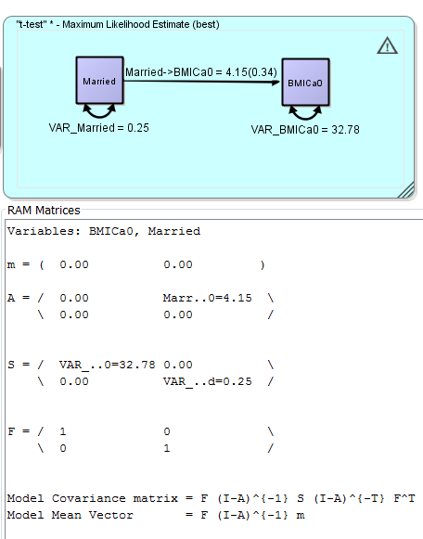
RAM notation
1. McArdle, J. J., & Boker, S. M. (1990). RAMpath: Path diagram software: Data Transforms.
2. McArdle, J. J. (2005). The development of the RAM rules for latent variable structural equation modeling. In A. Maydeu-Olivares & J. J. McArdle (Eds.), Contemporary psychometrics: A festschrift for Roderick P. McDonald (pp. 225-273).
3. Zhang, Z., Hamagami, F., Grimm, K. J., & McArdle, J. J. (2015). Using R Package RAMpath for Tracing SEM Path Diagrams and Conducting Complex Longitudinal Data Analysis. Structural Equation Modeling: A Multidisciplinary Journal, 22(1), 132-147.

Slide 34
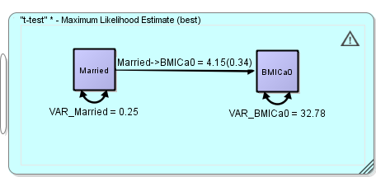
Lavaan code for lazy folk: From Ωnix
# This model specification was automatically generated by Onyx
#
library(lavaan);
modelData <- read.table(DATAFILENAME, header = TRUE) ;
model<-"
! regressions
BMICa0 ~ Married__BMICa0*Married
! residuals, variances and covariances
BMICa0 ~~ VAR_BMICa0*BMICa0
Married ~~ VAR_Married*Married
! observed means
BMICa0~1;
Married~1;
";
result<-lavaan(model, data=modelData, fixed.x=FALSE, missing="FIML");
summary(result, fit.measures=TRUE);

Slide 35
sem code for lazy folk: From Ωnix
# This model specification was automatically generated by Onyx
#
require("sem");
modelData <- read.table(DATAFILENAME, header = TRUE)
paths <- c("BMICa0 <-> BMICa0", "Married <-> Married", "Married -> BMICa0")
parameter <- c("VAR_BMICa0", "VAR_Married", "Married__BMICa0")
values <- c("32.776030306921605", "0.24691358028835825", "4.154875879839016")
model <- array(c(paths, parameter, values), dim = c(3,3))
colnames(model) <- c("col1","col2","col3")
result <- sem(model = model, data = modelData)
summary(result)

Slide 36
Lavaan code for lazy folk: From Ωnix
# This model specification was automatically generated by Onyx
#
library(lavaan);
modelData <- read.table(DATAFILENAME, header = TRUE) ;
model<-"
! regressions
BMICa0 ~ Married__BMICa0*Married
! residuals, variances and covariances
BMICa0 ~~ VAR_BMICa0*BMICa0
Married ~~ VAR_Married*Married
! observed means
BMICa0~1;
Married~1;
";
result<-lavaan(model, data=modelData, fixed.x=FALSE, missing="FIML");
summary(result, fit.measures=TRUE);

Slide 37
OpenMx code for lazy folk: From Ωnix
# This model specification was automatically generated by Onyx
require("OpenMx");
modelData <- read.table(DATAFILENAME, header = TRUE)
manifests<-c("BMICa0","Married")
latents<-c()
model <- mxModel("_t_test_",
type="RAM",
manifestVars = manifests,
latentVars = latents,
mxPath(from="Married",to=c("BMICa0"), free=c(TRUE), value=c(1.0) , arrows=1, label=c("Married__BMICa0") ),
mxPath(from="BMICa0",to=c("BMICa0"), free=c(TRUE), value=c(1.0) , arrows=2, label=c("VAR_BMICa0") ),
mxPath(from="Married",to=c("Married"), free=c(TRUE), value=c(1.0) , arrows=2, label=c("VAR_Married") ),
mxPath(from="one",to=c("BMICa0","Married"), free=F, value=0, arrows=1),
mxData(modelData, type = "raw")
);
result <- mxRun(model)
summary(result)

Slide 38
Appendix: a 2 versions of t tests
> t.test(dpp_36males_Hartford_fewer$BMICa0~dpp_36males_Hartford_fewer$married,var.equal=TRUE)
Two Sample t-test
data: dpp_36males_Hartford_fewer$BMICa0 by dpp_36males_Hartford_fewer$married
t = -2.1028, df = 34, p-value = 0.04296
alternative hypothesis: true difference in means is not equal to 0
95 percent confidence interval:
-8.1703995 -0.1393522
sample estimates:
mean in group 0 mean in group 1
30.56842 34.72329
vs. Welch t-test
Welch Two Sample t-test
data: dpp_36males_Hartford_fewer$BMICa0 by dpp_36males_Hartford_fewer$married
t = -2.2389, df = 30.278, p-value = 0.03266
alternative hypothesis: true difference in means is not equal to 0
95 percent confidence interval:
-7.9434686 -0.3662831
sample estimates:
mean in group 0 mean in group 1
30.56842 34.72329

Slide 39
Mplus code for lazy folk: From Ωnix
Variables: BMICa0, Married
37.0385 1.0259
1.0259 0.2469
!This model specification was automatically created by Onyx
TITLE:
"t-test"
DATA:
FILE IS "DATAFILENAME";
VARIABLE: NAMES ARE BMICA0 MARRIED ;
USEVARIABLES ARE BMICA0 MARRIED ;
MODEL:
! regressions of latents on manifest
! regressions of manifest on manifest
BMICA0 ON MARRIED*1.0;
! regressions of latents on latents or manifests
! residuals, variances and covariances
BMICA0*1.0;
MARRIED*1.0;
ANALYSIS:
TYPE = general;
ESTIMATOR = ml;
OUTPUT:
sampstat;

Slide 40
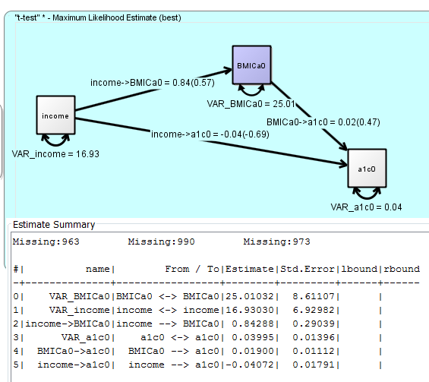
A more informed model: Ωnix
There is likely an indirect effect too here.

Slide 41
Appendix: a
fit <- sem(SEMJaccApp_d, data = dpp_36males_Hartford_fewer)
> summary(fit, rsq = T)
lavaan (0.5-23.1097) converged normally after 17 iterations
Number of observations 36
Estimator ML
Minimum Function Test Statistic 0.000
Degrees of freedom 0
Parameter Estimates:
Information Expected
Standard Errors Standard
Regressions:
Estimate Std.Err z-value P(>|z|) Std.lv Std.all
BMICa0 ~
married 4.155 1.920 2.164 0.030 4.155 0.339
Variances:
Estimate Std.Err z-value P(>|z|) Std.lv Std.all
.BMICa0 32.776 7.725 4.243 0.000 32.776 0.885
[only 1 variance estimated: but we have 2 groups…]
R-Square:
Estimate
BMICa0 0.115
vs. Welch t-test
Welch Two Sample t-test
data: dpp_36males_Hartford_fewer$BMICa0 by dpp_36males_Hartford_fewer$married
t = -2.2389, df = 30.278, p-value = 0.03266
alternative hypothesis: true difference in means is not equal to 0
95 percent confidence interval:
-7.9434686 -0.3662831
sample estimates:
mean in group 0 mean in group 1
30.56842 34.72329

Slide 42
Appendix: a
SEMJaccApp_a2 <- '
BMICa0~1
‘
fit <- sem(SEMJaccApp_a2,
+ data = dpp36,
+ group = "married")
Estimator ML
Model Fit Test Statistic 0.000
Degrees of freedom 0
Number of observations per group
0 16
Group 1 [0]:
Intercepts:
Estimate Std.Err z-value P(>|z|)
BMICa0 30.568 0.929 32.917 0.000
Variances:
Estimate Std.Err z-value P(>|z|)
BMICa0 13.798 4.878 2.828 0.005
vs. Welch t-test
Welch Two Sample t-test
t = -2.2389, df = 30.278, p-value = 0.03266
95 percent confidence interval:-7.9434686 -0.3662831
sample estimates:
mean in group 0 mean in group 1
30.56842 34.72329
lavaan 0.6-3 ended normally after 15 iterations
Optimization method NLMINB
Number of free parameters 4
Chi-square for each group:
0 0.000
1 0.000
Parameter Estimates:
Information Expected
Information saturated (h1) model Structured
Standard Errors Standard
Number of observations per group
1 20
Group 2 [1]:
Intercepts:
Estimate Std.Err z-value P(>|z|)
BMICa0 34.723 1.549 22.424 0.000
Variances:
Estimate Std.Err z-value P(>|z|)
BMICa0 47.958 15.166 3.162 0.002
vs. Welch t-test
Welch Two Sample t-test
t = -2.2389, df = 30.278, p-value = 0.03266
alternative hypothesis: true difference in means is not equal to 0
mean in group 0 mean in group 1
30.56842 34.72329

Slide 43
Appendix: a
> anova(fitdif,fiteq )
Chi Square Difference Test
Df AIC BIC Chisq Chisq diff Df diff Pr(>Chisq)
fitdif 0 236.19 239.36 0.0000
fiteq 1 232.45 237.20 4.8911 4.8911 1 0.027 *
> fiteq <- sem(SEMJaccApp_a2,
data = dpp36, group = "married",
group.equal = c("intercepts"))
lavaan 0.6-3 ended normally after 15 iterations
Optimization method NLMINB
Number of free parameters 4
Estimator ML
Model Fit Test Statistic 4.891
Degrees of freedom 1
P-value (Chi-square) 0.027
Number of observations per group
0 16
Group 1 [0]:
Intercepts:
Estimate Std.Err z-value P(>|z|)
BMICa0 (.p1.) 31.576 0.837 37.703 0.000
Variances:
Estimate Std.Err z-value P(>|z|)
BMICa0 14.813 5.237 2.828 0.005
vs. Welch t-test
Welch Two Sample t-test
t = -2.2389, df = 30.278, p-value = 0.03266
95 percent confidence interval:
-7.9434686 -0.3662831
sample estimates:
mean in group 0 mean in group 1
30.56842 34.72329
Chi-square for each group:
0 1.135
1 3.756
Parameter Estimates:
Information Expected
Information saturated (h1) model Structured
Standard Errors Standard
Number of observations per group
1 20
Group 2 [1]:
Intercepts:
Estimate Std.Err z-value P(>|z|)
BMICa0 (.p1.) 31.576 0.837 37.703 0.000
Variances:
Estimate Std.Err z-value P(>|z|)
BMICa0 57.866 18.299 3.162 0.002
vs. Welch t-test
Welch Two Sample t-test
t = -2.2389, df = 30.278, p-value = 0.03266
alternative hypothesis: true difference in means is not equal to 0
sample estimates:
mean in group 0 mean in group 1
30.56842 34.72329

Slide 44
Appendix a : Compare means in 2 independent groups
Classic
Model is… a t-test
Welch Two Sample t-test
t(df=1) = -2.2389, p = 0.033
Modern
Model is a 2 group 1 effect variable (no cause)
[ContinuousEffect_{Group1} & ContinousEffect_{Group2}]
Chi Square Difference Test
χ²diff(df=1) = 4.8911 , p= 0.027

Slide 45
Pre-data: in DAG world
# 2 DAG
DagJaccApp_a2 <- dagitty('dag {
Married[pos="1,2"]
BMI [pos="2,2"]
Married-> BMI
}')
plot (DagJaccApp_a2)
#then can technically simulate data DID NOT WORK
DagJaccApp_a2 <- simulateSEM( g, .2, .3)
coef( summary( lm( BMI ~ Married, DagJaccApp_a2 ) ) )
Johannes Textor, Andrew Forney, and Judea Pearl (2016). Causal Inference In Statistics: A Companion for R Users
Banack, H. R., & Kaufman, J. S. (2015). From bad to worse: collider stratification amplifies confounding bias in the “obesity paradox”. European journal of epidemiology, 1-4.

Slide 46
Pre-data: in MIIVsem world
##1 MIIVsem
model.MiivJaccApp_a2 <- '
BMI ~ Married
+ '
miivs(model.MiivJaccApp_a2)
Model Equation Information
LHS RHS MIIVs
BMI Married Married
CRAN - Package MIIVsem
GitHub - zackfisher/MIIVsem
Bollen, K. A., & Fisher, Z. (2017). Model Implied Instrumental Variable (MIIV) Methods using MIIVsem: An R Package for Structural Equation Models (SEMs). Paper presented at the Modern Modeling Methods (M3) Conference, Storrs, CT.
https://miivs.shinyapps.io/miivs/
Bollen, K. A. (2018). Model Implied Instrumental Variables (MIIVs): An Alternative Orientation to Structural Equation Modeling. Multivariate Behavioral Research, 1-16.

Slide 47
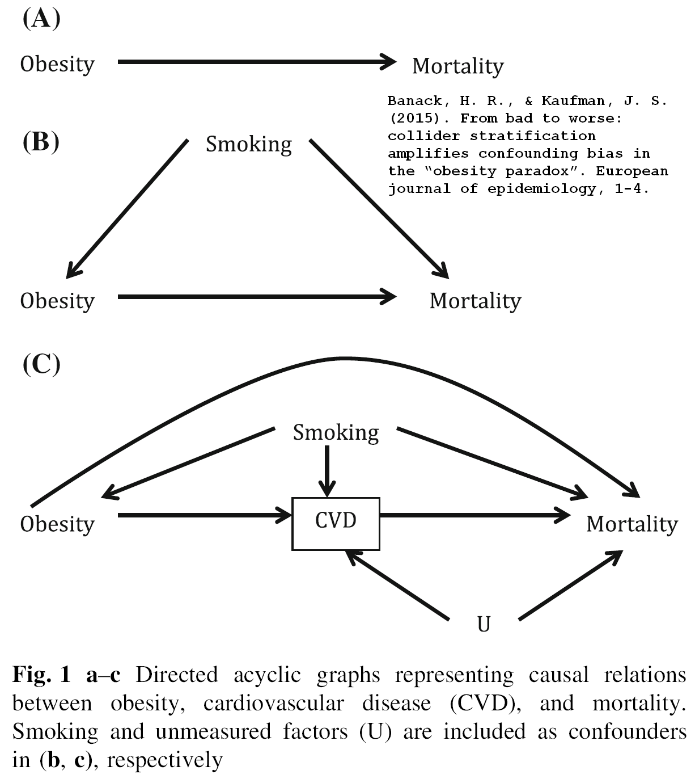
Example 2: obesity paradox” Pre-data: in DAG world
Banack, H. R., & Kaufman, J. S. (2015). From bad to worse: collider stratification amplifies confounding bias in the “obesity paradox”. European journal of epidemiology, 1-4.

Slide 48
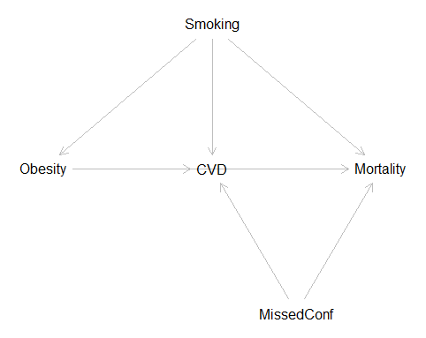
Obesity paradox” Pre-data: in DAG world
g <- dagitty('dag {
Obesity [pos="0,1"]
CVD [pos="1,1"]
Mortality [pos="2,1"]
Smoking [pos="1,0"]
MissedConf [pos="1.5,2"]
Obesity -> CVD -> Mortality <- MissedConf
Obesity <- Smoking -> CVD <- MissedConf
Smoking -> Mortality
Obesity-> Mortality
}')
plot(g)
Johannes Textor, Andrew Forney, and Judea Pearl (2016). Causal Inference In Statistics: A Companion for R Users
Banack, H. R., & Kaufman, J. S. (2015). From bad to worse: collider stratification amplifies confounding bias in the “obesity paradox”. European journal of epidemiology, 1-4.

Slide 49
Obesity paradox” Pre-data: in MIIVsem
model.obesparadox <- '
Mortality ~ CVD +MissedConf + Smoking +Obesity
CVD ~ Obesity + MissedConf + Smoking
Obesity ~ Smoking
‘
miivs(model.obesparadox)
Model Equation Information
LHS RHS MIIVs
Mortality MissedConf, Smoking, CVD, Obesity CVD, Obesity, MissedConf, Smoking
CVD MissedConf, Smoking, Obesity Obesity, MissedConf, Smoking
Obesity Smoking MissedConf, Smoking
GitHub - zackfisher/MIIVsem

Slide 50
Obesity paradox” Which adjustments are required
“List all of the sets of variables that satisfy the backdoor criterion to determine the causal effect of Obesity on Mortality.”
This is the cherry on the cake:
One HAS TO to measure smoking, OR smoking and the Missed Confounder, in order to identify the causal effect of Obesity on Mortality.
adjustmentSets( g, "Obesity", "Mortality", type="all" )
{ Smoking }
{ MissedConf, Smoking }
Johannes Textor, Andrew Forney, and Judea Pearl (2016). Causal Inference In Statistics: A Companion for R Users
Banack, H. R., & Kaufman, J. S. (2015). From bad to worse: collider stratification amplifies confounding bias in the “obesity paradox”. European journal of epidemiology, 1-4.

Slide 51
Why bother
Modern
1. It allows one to think in causal modeling manner
2. It is more flexible modeling: allows for fewer ‘unrelaxable’ assumptions, and can test assumptions along the way
3. The reality operates as different effects in different populations, e.g. health disparities: the effect in income on health differs for races/ethnic groups
4. It open the doors for formal causal inquiries: when and how can one recover causal effects with simple regressions, e.g.

Slide 52
Next:
What you may have learned
1. R is not that scary: nor is causal modeling
2. Causal calculus’ has been implemented and is easy to use on dagitty
3. Several traditions have been merged in designing MIIVsem (economics, latent variables)
4. One can better teach/train by using graphical models: Onyx is there to help.
5. Answering ‘what if’ questions require solid causal footing:
the science of cause and effect is here with us
The science of cause and effect is ‘complete’: Elias Bareinboim will come to Storrs to prove it.

